Slide 1

SOCIAL DISTANCING DETECTION USING EUCLIDEAN ALGORITHM FOR COVID-19
Presented By:
Srinivas M
(1DB17CS146)
UNDER THE GUIDANCE:
VINAKA PATIL
Associate Prof
Dept of CSE,DBIT

Slide 2
AGENDA
The ongoing COVID-19 corona virus outbreak has caused a global disaster with its deadly spreading. Due to the absence of effective remedial agents and the shortage of immunizations against the virus, population vulnerability increases. In the current situation, social distancing is thought to be an adequate precaution (norm) against the spread of the pandemic virus. The risks of virus spread can be minimized by avoiding physical contact among people. The purpose of this work is, therefore, to provide a deep learning platform for social distance tracking using an overhead perspective. Using the Euclidean distance, the detected bounding box centroid's pairwise distances of people are determined. To estimate social distance violations between people, we used an approximation of physical distance to pixel and set a threshold. A violation threshold is established to evaluate whether or not the distance value breaches that minimum social distance threshold.

Slide 3




TABLE OF CONTENTS
03
01
02
INTRODUCTION
PROBLEM DEFINITION
LITERATURE SURVEY
04
05
06
OBJECTIVE
IMPLEMENTATION
RESULTS

Slide 4
01.INTRODUCTION
1)The spread of COVID-19 virus and the ensuing large-scale lockdowns across the globe has given rise to an alarming situation. The resumption sectors is a key pre-requisite for kick starting economic activity of a nation. The safety of the workforce operating these plants cannot be compromised. 2) Euclid's algorithm, is an efficient method for computing the greatest common divisor (GCD) of two integers (numbers), the largest number that divides them both without a remainder. 3) The Euclidean Distance procedure computes similarity between all pairs of items. It is a symmetrical algorithm, which means that the result from computing the similarity of Item A to Item B is the same as computing the similarity of Item B to Item A. We can therefore compute the score for each pair of nodes once. Social-distancing is an important way to slow down the spread of infectious diseases. People are asked to limit their interactions with each other, reducing the chances of the disease being spread with physical or close contact.

Slide 5
02.PROBLEM DEFINITION
1)Due to Covid-19 pandemic situation we can’t even come in close contact with each other or can’t even touch each other.
2)Due to this situation school and colleges have been closed in order to avoid spread of covid19.
3)So we are proposing a model which will detect the person maintaining the social distance

Slide 6
03. LITERATURE SURVEY
1> Managing Crowds with Wireless and Mobile Technologies
Author: Mohammad Yamin, Abdullah M, Baahel, Adnan A, Abi Sen
Prediction of the size and nature of the irregular and spontaneous crowds is very difficult due to many uncertainties surrounding them. Radio Frequency Identification (RFID) [19] technology and tools, which are already being used for tracking the movements of people, vehicles, goods etc., can help to manage some of the problems of crowding.

Slide 7
2> Person Detection For Social Distance and Safety Violation Alert based on Segmented ROI
Author: Afiq Harith, Ahamad Noliza Zaini, Mohd Fuad Abdul Latip
The main purpose of this system is to process captured video footage for person detection and further processing for social distancing or safety violation. So, the process starts with reading the frames of a video feed one by one.
The most important feature of this study is the object detection framework. This is due to the element of this study that focuses on determining the location of a person from the input frame. Hence, choosing the most suitable object detection model is important to avoid any problems in detecting persons.

Slide 8
3> The Visual Social Distancing Problem
Author: Macro Cristani, Francesco Setti, Alessandro Vinciarelli, Alessio Del Bue
Introduce the Visual Social Distancing (VSD) problem, defined as the automatic estimation of the inter-personal distance from an image, and the characterization of related people aggregations. VSD is pivotal for a non-invasive analysis to whether people comply with the SD restriction, and to provide statistics about the level of safety of specific areas whenever this constraint is violated. We first point out that measuring VSD is not only a geometrical problem, but it also implies a deeper understanding of the social behaviour in the scene.
Estimating the VSD requires the solution of a set of classical computer vision and social Signal Processing tasks as identified namely, scene geometry understanding person detection/ body pose estimation and social distance characterization.

Slide 9
04. OBJECTIVE
To present a deep learning-based social distance monitoring framework using an overhead view perspective.
To calculate the distance between human objects using Euclidean distance algorithm.
In order to track the social distance between individuals, the Euclidean distance is used to approximate the distance between each pair of the centroid of the bounding box detected. In addition, a social distance violation threshold is specified using a pixel to distance estimation.

Slide 10
05. IMPLEMENTATION
Euclidean distance algorithm:
Euclidean distance algorithm is used to calculate the distance between two points
Finding the Euclidean distance between points depends on the particular dimensional space
Euclidean distance = the square root of sum of square points(p1,p2)
Here p1,p2 are the two points for calculating Euclidean distance

Slide 11
During human identification, as seen in , the input frame is divided into a region of S×S, also called grid cells. These cells are related to bounding box estimation and class probabilities. It predicts the probability of whether the center of the person bounding box is in the grid cell or not. we measure the distance between each detected centroid using Euclidean distance. For every subsequent frame in the video stream, we firstly compute bounding box centroids and then calculate the distance (highlighted with red lines) between each pair of detected bounding box centroids. The information of each centroid is stored in the form of a list. Based on distance values, a threshold is defined to check if any two people are less than pixels apart or not. If the distance violates the minimum social distance set or two people are too close, then the information is added into the violation set. The bounding box color is initialized as green. The information is checked in the violation set; if the current index exists violation set, the color is updated to red.

Slide 12
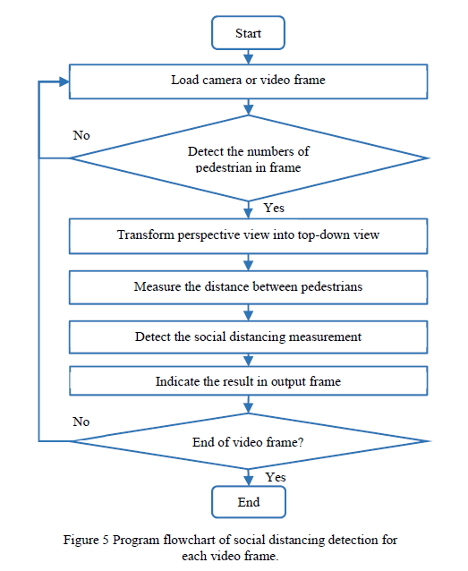
FLOWCHART

Slide 13
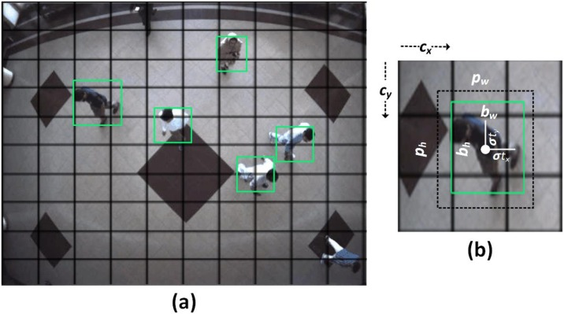
Detected coordinates of person bounding box.

Slide 14
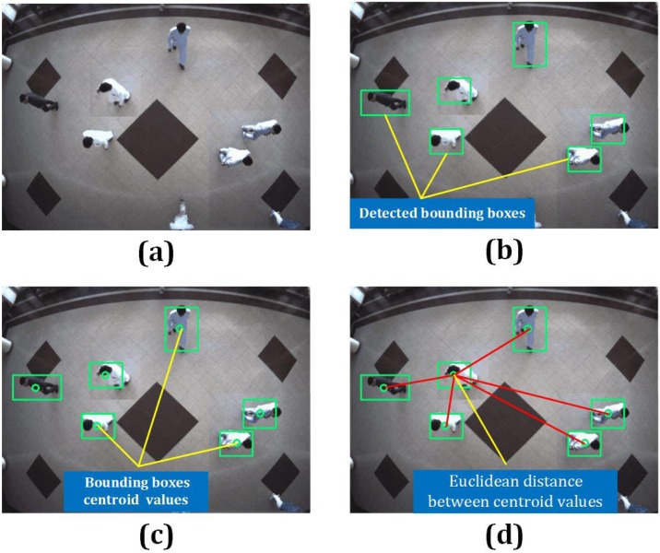
06. RESULTS

Slide 15
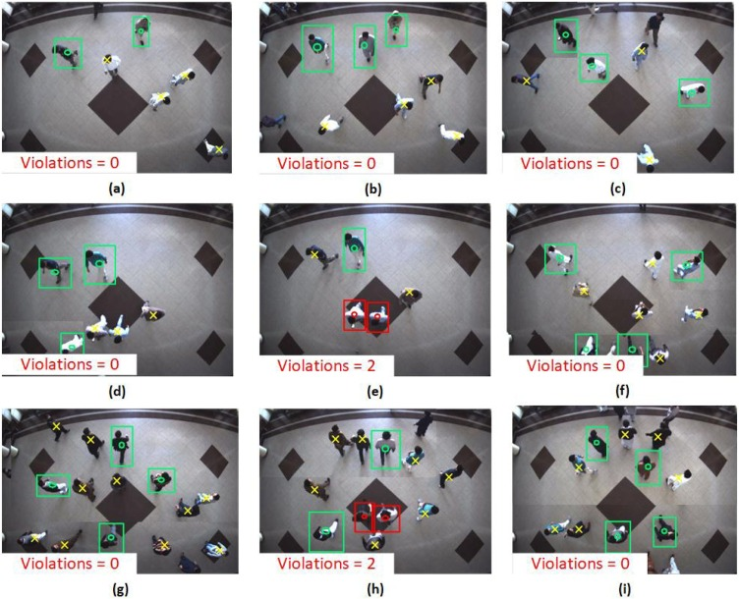

Slide 16
The detection model gives bounding box information, containing centroid coordinates information. Using the Euclidean distance, the pairwise centroid distances between detected bounding boxes are measured. To check social distance violations between people, an approximation of physical Distance to the pixel is used, and a threshold is defined. A violation threshold is used to check if the distance value violates the minimum social distance set or not.
07. CONCLUSION

Slide 17
REFERENCE
1)Mohammad Yamin, Abdullah M.Baahel, Adnan A. Abi Sen- Managing Crowds with Wireless and Mobile Technologies, August 2018 2) Afiq Harith Ahamad, Norliza Zaini, Mohd Fuad Abdul Latip- Person Detection for Social Distancing and Safety Violation Alert based on Segmented ROI, 10th IEEE conference , 21 - 22 August 2020
3) Narinder Singh Punn, Sanjay Kumar Sonbhadra and Sonali Agarwal-Monitoring COVID-19 social distancing withperson detection and tracking via ﬁne-tuned YOLOv3 and Deepsort techniques, 4 may 2020

Slide 18
THANK YOU ALL
Front view of social distance concept

